Slide 1

WELCOME
COHORT 5
7th Sept – 3rd Dec 2026
Suite 6-6-7, Level 6, Menara MAA

Slide 2
Introduction to Backend Development
How frontend and backend work together
Intro to Python
Python Setup
Python programming fundamentals

Slide 3
Frontend (Client-Side)
Backend (Server-Side)
"front part" that users see and interact with directly.
Responsible for:
UI/UX
Visual elements (buttons, forms, layouts)
Form validation
Animation
"behind-the-scenes" part that is essential but invisible to users.
Responsible for:
Processing data
Business logic
Database operations
Security
API endpoints

Slide 4
Example
You tell the Waiter you want a burger. (Frontend)
The Waiter writes the order down and carries that "request" over to the Kitchen. (Backend)
The Chef (Backend) receives the order. They go to the Fridge (Database) to check if there is beef available and cook it. (Backend/Database)
Once the burger is ready, the Chef tells the Waiter, "Order 42 is ready!" (Backend ➡️ Frontend)
The Waiter brings the burger to your table and says, "Enjoy your meal!" (Frontend)

Slide 5
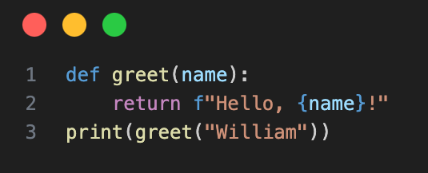
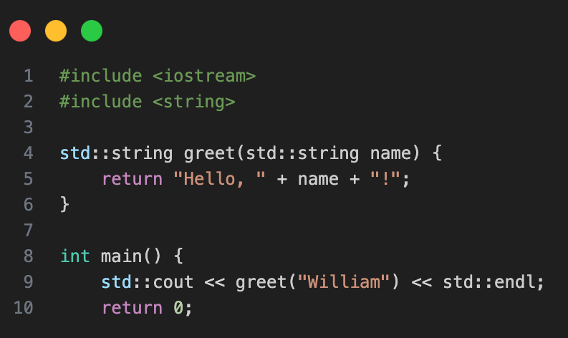
Why Python?
Easy to learn and read
Use:
  web dev
  data science
  AI
Large community & resources
Extensive library support
Download:
https://www.python.org/downloads/release/python-3127/

Slide 6
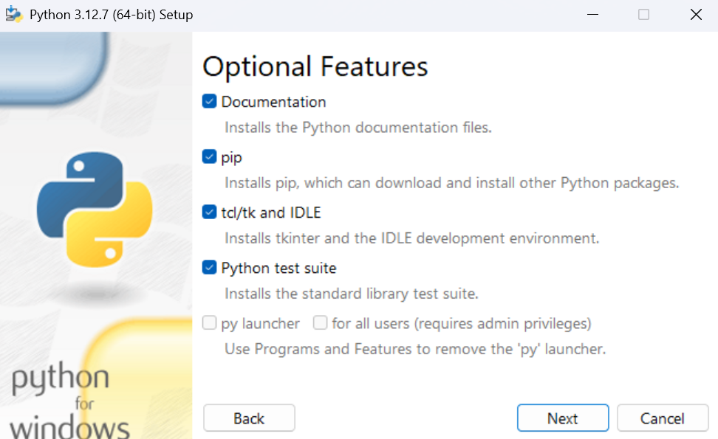

Slide 7
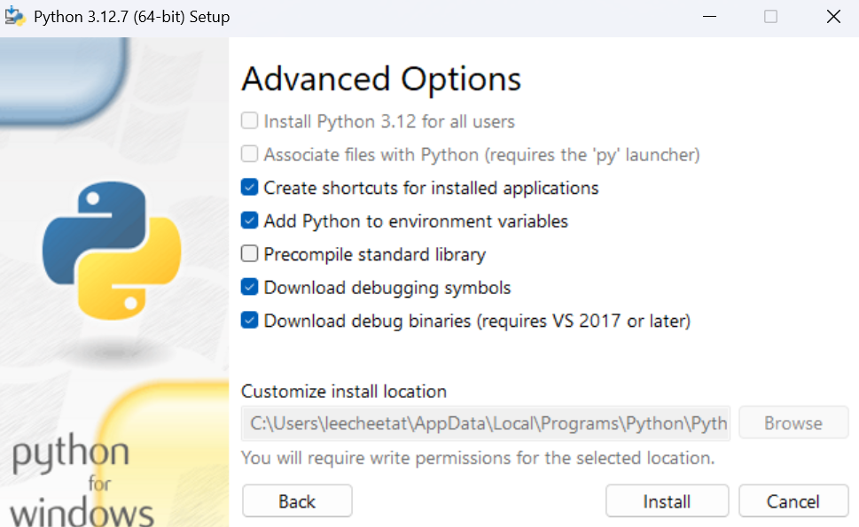

Slide 8
Python Basic Command
Open terminal:
Check list of installed Python
py --list
Check default version
py --version
python3 --version (mac)
Change default Python version
setx PY_PYTHON 3.12
(close command line and reopen)

Slide 9
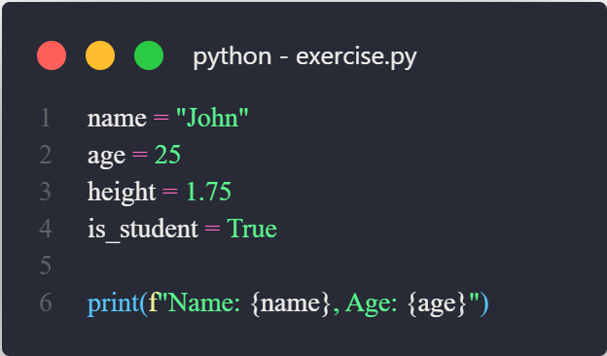
Python Basic Syntax
Create a file with .py at the end. Copy the code and run it. How to run? Either click the run button or in the terminal, run this “python filename.py” (Windows) or “python3 filename.py” (Mac)

Slide 10
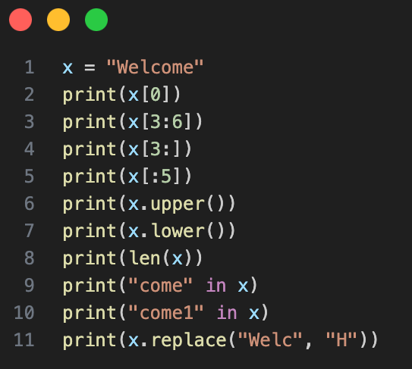
Strings
Ref: https://www.w3schools.com/python/python_strings_methods.asp
Notes:
# ============================================================
# LESSON: Strings in Python
# A "string" is just text — letters, words, sentences.
# We wrap it in quotes so Python knows it's text, not code.
# ============================================================
# ------------------------------------------------------------
# 1. INDEXING — grabbing ONE character
# Think of each letter having a seat number, starting at 0
#
# W e l c o m e
# 0 1 2 3 4 5 6
# ------------------------------------------------------------
# 'W' ← seat 0
# 'e' ← seat 1
# 'c' ← seat 3
# ------------------------------------------------------------
# 2. SLICING — grabbing a RANGE of characters [start : stop]
# "stop" is exclusive — Python stops just BEFORE that seat
# ------------------------------------------------------------
# 'com' ← seats 3, 4, 5 (stops before 6)
# 'come' ← seat 3 to the END
# 'Welco' ← from the START up to (not including) seat 5
# ------------------------------------------------------------
# 3. USEFUL STRING METHODS
# ------------------------------------------------------------
# 'WELCOME' — all caps
# 'welcome' — all lowercase
# 7 — total number of characters
# True — does this word exist inside?
# False — nope, "come1" isn't in there
# 'Home' — swap one part for another
# ------------------------------------------------------------
# 4. COMBINING STRINGS (called "concatenation")
# ------------------------------------------------------------
# Method A: + operator — glues strings together
# 'Welcome Home'
# Method B: f-string — fill-in-the-blank style (most modern & readable)
# 'Welcome Home'
# f-strings are preferred for longer sentences:
# 'Welcome to Kuala Lumpur, Home!'

Slide 11
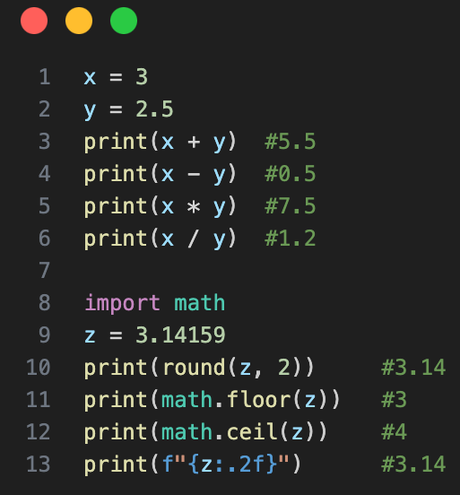
Numbers
Ref: https://www.w3schools.com/python/python_math.asp
Notes:
# ============================================================
# LESSON: Numbers in Python
# Two types:
# int — whole numbers e.g. 3, 10, -7
# float — numbers with a dot e.g. 2.5, 3.14, -0.9
# ============================================================
# ------------------------------------------------------------
# 1. BASIC ARITHMETIC
# Mixing int + float always gives back a float
# ------------------------------------------------------------
# 5.5 — addition
# 0.5 — subtraction
# 7.5 — multiplication
# 1.2 — division (always returns float)
# ------------------------------------------------------------
# 2. ROUNDING — four different ways, each with a use case
# ------------------------------------------------------------
# A) round() — standard rounding, built into Python (no import needed)
# 3.14 ← rounds to nearest, 2 decimal places
# B) math.floor() — always rounds DOWN (floor = ground level)
# 3
# 3.14
# step-by-step: floor(314.159) → 314 → 314/100 → 3.14
# C) math.ceil() — always rounds UP (ceil = ceiling)
# 4
# 3.15
# step-by-step: ceil(314.159) → 315 → 315/100 → 3.15
# Quick memory trick:
# floor(2.9) → 2 floor always goes DOWN to the lower whole number
# ceil(2.1) → 3 ceil always goes UP to the higher whole number
# ------------------------------------------------------------
# 3. FORMATTING NUMBERS — controlling how numbers are displayed
# Uses f-strings: f"{ value : format_code }"
# ------------------------------------------------------------
# .2f → fixed decimal places (f = fixed-point)
# '3.14' — show exactly 2 decimal places
# .2% → convert to percentage, show 2 decimal places
# '314.16%' — Python multiplies by 100 automatically
# step-by-step: 3.14159 × 100 = 314.159% → rounded to 2dp → 314.16%

Slide 12
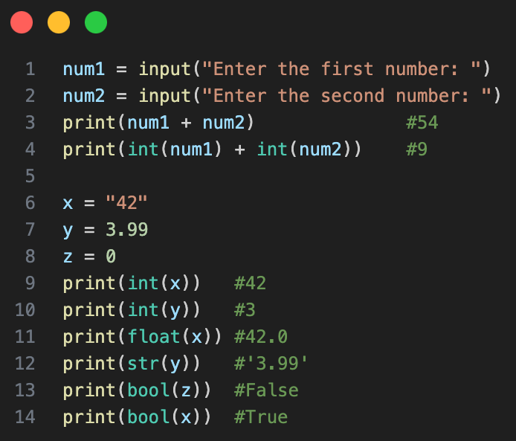
Cast
Ref: https://www.w3schools.com/python/python_casting.asp
Notes:
# ============================================================
# LESSON: Type Casting
# "Casting" = converting a value from one data type to another
#
# The 4 main types you'll cast between:
# str — text "hello", "3"
# int — whole number 3, 10
# float — decimal 3.0, 2.5
# bool — true/false True, False
# ============================================================
# ------------------------------------------------------------
# 1. WHY CASTING EXISTS — the classic beginner trap
# ------------------------------------------------------------
# input() ALWAYS returns a string, even if the user types a number
# e.g. user types 5 → stored as "5"
# e.g. user types 3 → stored as "3"
# "53" ← WRONG! Python glued two strings together
# because + on strings means "combine"
# Fix: cast to int first
# 8 ← NOW it does real math
# ------------------------------------------------------------
# 2. THE FOUR CASTING FUNCTIONS
# ------------------------------------------------------------
# 42 str → int (must be a whole number string)
# 3 float→ int (cuts off the decimal, does NOT round)
# 42.0 str → float
# '3.99' float→ str
# False int → bool (0 = False, anything else = True)
# True str → bool (empty string "" = False, anything else = True)
# ------------------------------------------------------------
# 3. REAL EXAMPLE — putting it all together
# ------------------------------------------------------------
# user types 19.99 → stored as "19.99"
# user types 3 → stored as "3"
# cast before calculating!
# 'Total: $59.97'

Slide 13
Exercise: Temperature Converter
Create a program that:
1. Converts Celsius to Fahrenheit
2. Accepts user input
3. Prints the result
Formula: (C × 9/5) + 32 = F
Notes:
def celsius_to_fahrenheit():
try:
# Insert your code here
except ValueError:
# insert your code here
celsius_to_fahrenheit()
SOLUTION:
# Temperature Converter
# Defines a function to hold the logic.
def celsius_to_fahrenheit():
# A 'try' block lets you test a block of code for errors.
try:
# 1. Prompts the user in the terminal and reads the input as a string.
# 2. float() attempts to convert that string into a number with decimals.
celsius = float(input("Enter temperature in Celsius: "))
# The core conversion formula.
fahrenheit = (celsius * 9/5) + 32
# Prints the final, formatted result to the terminal.
# The :.2f formats the Fahrenheit number to two decimal places.
print(f"{celsius}°C is equal to {fahrenheit:.2f}°F")
# If float() fails (e.g., the user typed "abc"), a ValueError occurs.
# This 'except' block catches that specific error.
except ValueError:
# It then prints a user-friendly error message instead of crashing.
print("Please enter a valid number!")
# This line calls the function to start the program.
celsius_to_fahrenheit()

Slide 14
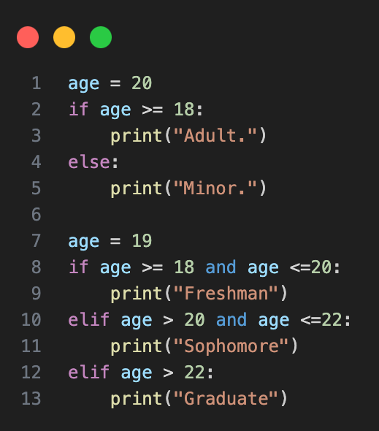
If…Else
Ref: https://www.w3schools.com/python/python_if_elif.asp
Notes:
# ============================================================
# LESSON: Conditionals & Logic
# Making decisions in code based on conditions
# ============================================================
# ------------------------------------------------------------
# 1. IF / ELSE — the simplest decision
# ------------------------------------------------------------
# ------------------------------------------------------------
# 2. IF / ELIF / ELSE — multiple conditions (comparison operators)
#
# >= greater than or equal <= less than or equal
# > greater than < less than
# == exactly equal != not equal
# ------------------------------------------------------------
# Note: order matters! Python checks top to bottom and stops at the first True

Slide 15
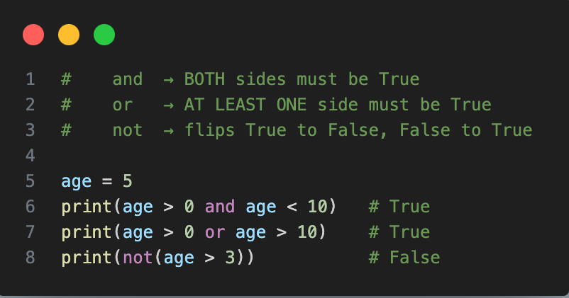
Logical
Ref: https://www.w3schools.com/python/python_if_logical.asp
Notes:
# ------------------------------------------------------------
# 3. LOGICAL OPERATORS — combining conditions
# and → BOTH sides must be True
# or → AT LEAST ONE side must be True
# not → flips True to False, False to True
# ------------------------------------------------------------

Slide 16
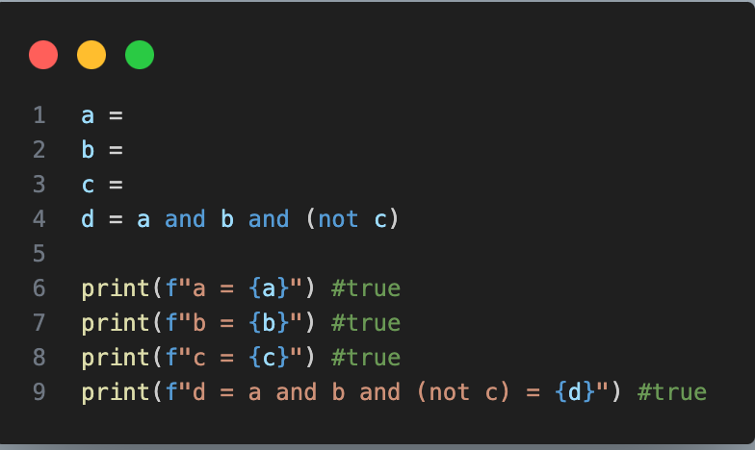
Exercise
Find the Boolean values for a, b, and c so d return True:
Notes:
# ------------------------------------------------------------
# 4. BOOLEAN VALUES — how Python decides True or False
#
# 0 → False any other number → True
# "" → False any text → True
# (think: empty = False, something = non-False)
# ------------------------------------------------------------
# ------------------------------------------------------------
# 5. EXERCISE — guess a number
# Rule: 0 = False, any other number = True
# Can you find a number that makes x = False?
# ------------------------------------------------------------

Slide 17
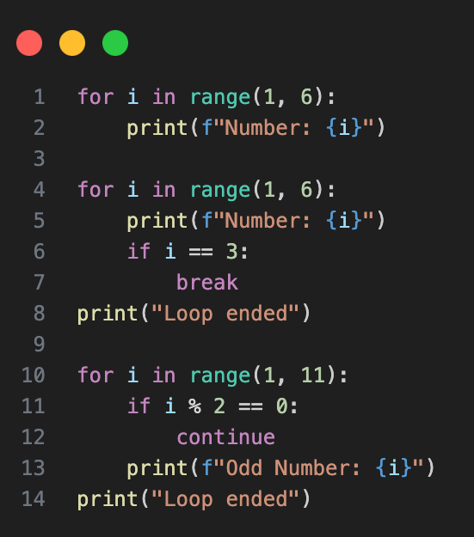
For Loop
Ref: https://www.w3schools.com/python/python_for_loops.asp
Notes:
% - Modulo Operator
# ============================================================
# LESSON: For Loops
# A loop repeats code a set number of times automatically.
# ============================================================
# ------------------------------------------------------------
# 1. BASIC FOR LOOP -- range(start, stop)
# starts at 'start', counts up by 1, stops BEFORE 'stop'
# ------------------------------------------------------------
# i = 1, 2, 3, 4, 5
# range(1, 6) -> 1 2 3 4 5 (stops before 6)
# range(0, 5) -> 0 1 2 3 4 (stops before 5)
# range(5) -> 0 1 2 3 4 (shorthand for range(0, 5))
# ------------------------------------------------------------
# 2. BREAK -- exit the loop early when a condition is met
# ------------------------------------------------------------
# stop the loop immediately at 3
# Output: 1, 2, 3, Loop ended
# Python hits break at i=3 and jumps straight to Loop ended
# ------------------------------------------------------------
# 3. CONTINUE -- skip THIS step, keep going with the next
# ------------------------------------------------------------
# % = remainder after division
# even number? skip it, go to next i
# % (modulo) trick:
# 5 % 2 = 1 -> odd (remainder is 1, not zero)
# 6 % 2 = 0 -> even (remainder is 0, divides cleanly)
# Output: 1, 3, 5, 7, 9, Loop ended
# ------------------------------------------------------------
# SUMMARY
# range(start, stop) -- controls how many times the loop runs
# break -- STOP the loop entirely
# continue -- SKIP this round, keep looping
# ------------------------------------------------------------

Slide 18
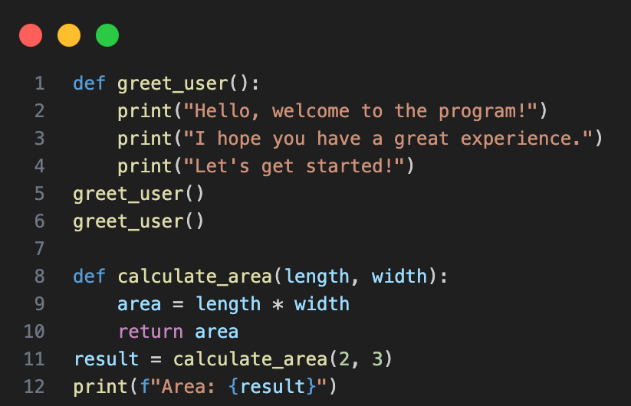
Function
Ref: https://www.w3schools.com/python/python_functions.asp
Notes:
# ============================================================
# LESSON: Functions
# A function is a reusable block of code you define once
# and call (run) whenever you need it.
# def = short for 'define'
# ============================================================
# ------------------------------------------------------------
# 1. BASIC FUNCTION -- no input, no output, just does a task
# ------------------------------------------------------------
# calling the function -- this is what actually runs it
# can call it as many times as you want
# ------------------------------------------------------------
# 2. FUNCTION WITH ARGUMENTS -- pass in values to work with
# argument = the value you send IN to the function
# parameter = the variable that receives it inside the function
# ------------------------------------------------------------
# length & width are parameters
# send the result back out
# 2 & 3 are arguments
# return vs print:
# print -- just displays the value, nothing is saved
# return -- sends the value back so you can store or reuse it
# ------------------------------------------------------------
# 3. GLOBAL vs LOCAL VARIABLES
# Local -- created inside a function, only exists in there
# Global -- created outside, exists everywhere in the file
# ------------------------------------------------------------
# global variable
# local x -- separate from global x
# still 10 -- global unchanged
# ------------------------------------------------------------
# 4. USING global KEYWORD -- force the function to modify global x
# ------------------------------------------------------------
# reset global
# tells Python: use the global x
# now 5 -- global was changed
# Rule of thumb: avoid global when possible.
# Better to pass values in as arguments and return results.

Slide 19
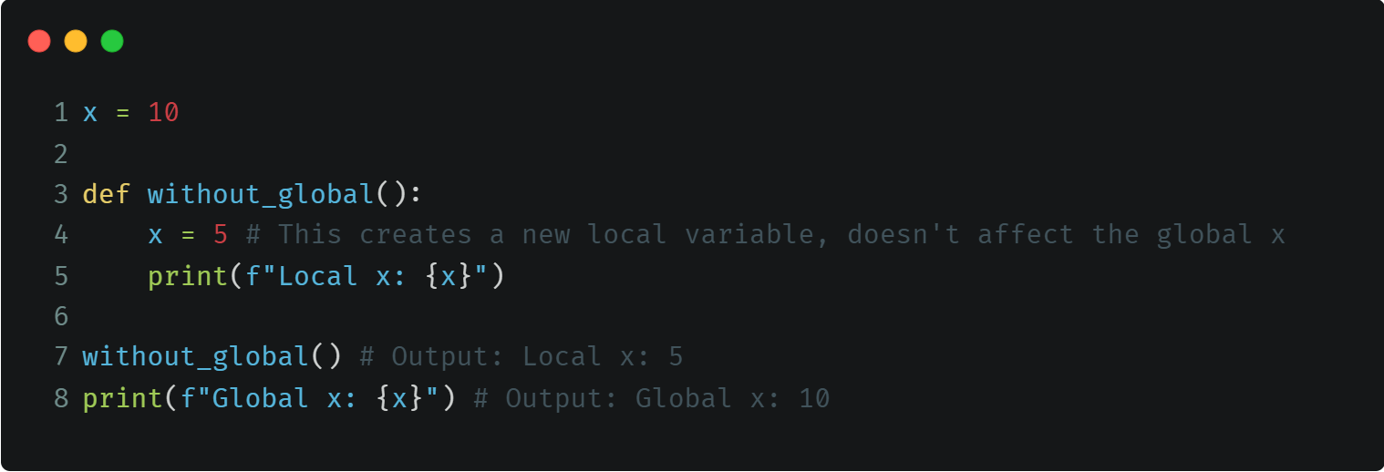
Function - Global Variable
Question: How to access Global x variable from inside without_global def?
Notes:
Answer: You use the global keyword in the function => global = x

Slide 20
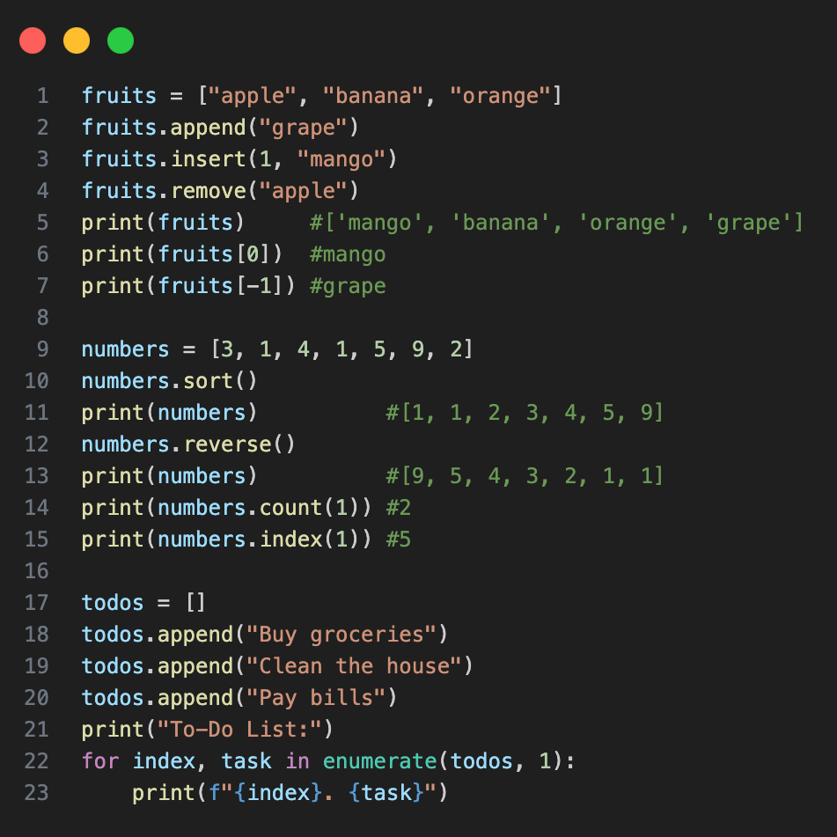
Lists
Ref: https://www.w3schools.com/python/python_lists.asp
Notes:
# ============================================================
# LESSON: Lists
# A list stores multiple values in one variable, in order.
# Uses square brackets [ ]
# ============================================================
# ------------------------------------------------------------
# 1. ADDING & REMOVING ITEMS
# ------------------------------------------------------------
# add to the END
# insert 99 at index 1 (shifts others right)
# remove first occurrence of value 1
# first item (index starts at 0)
# last item (-1 counts from end)
# ------------------------------------------------------------
# 2. USEFUL LIST METHODS
# ------------------------------------------------------------
# sort ascending, changes the list directly
# reverse order, changes the list directly
# how many times does 1 appear?
# at what index is 4?
# ------------------------------------------------------------
# 3. COPYING A LIST -- watch out for this common trap!
# ------------------------------------------------------------
# reset to a clean simple list
# WRONG way -- both variables point to the SAME list in memory
# original changed too!
# reset again
# RIGHT way -- .copy() creates a brand new independent list
# original safe
# only copy is sorted
# ------------------------------------------------------------
# 4. LOOPING THROUGH A LIST
# enumerate() gives you the index AND the value together
# ------------------------------------------------------------
# start counting from 1
# Output:
# 1. Buy groceries
# 2. Clean the house
# 3. Pay bills

Slide 21
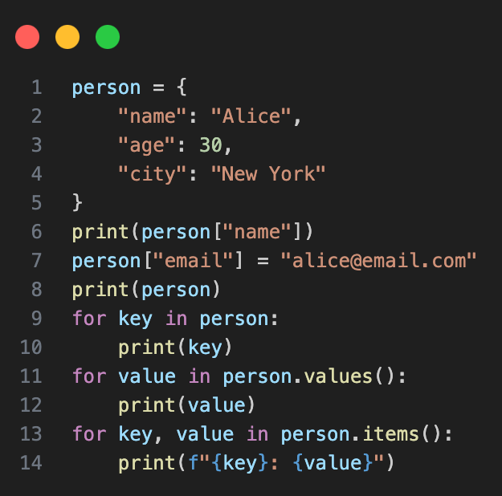
Dictionaries
Ref: https://www.w3schools.com/python/python_dictionaries.asp
Notes:
# ============================================================
# LESSON: Dictionaries
# Stores data as key: value pairs -- like a real dictionary.
# Uses curly braces { }
# ============================================================
# ------------------------------------------------------------
# 1. CREATING & UPDATING A DICTIONARY
# ------------------------------------------------------------
# "Alice" -- access by key
# add a new key:value pair
# ------------------------------------------------------------
# 2. LOOPING THROUGH A DICTIONARY -- three ways
# ------------------------------------------------------------
# keys only
# values only
# both key and value
# Output of .items():
# name: Alice
# age: 30
# city: New York
# email: alice@email.com

Slide 22
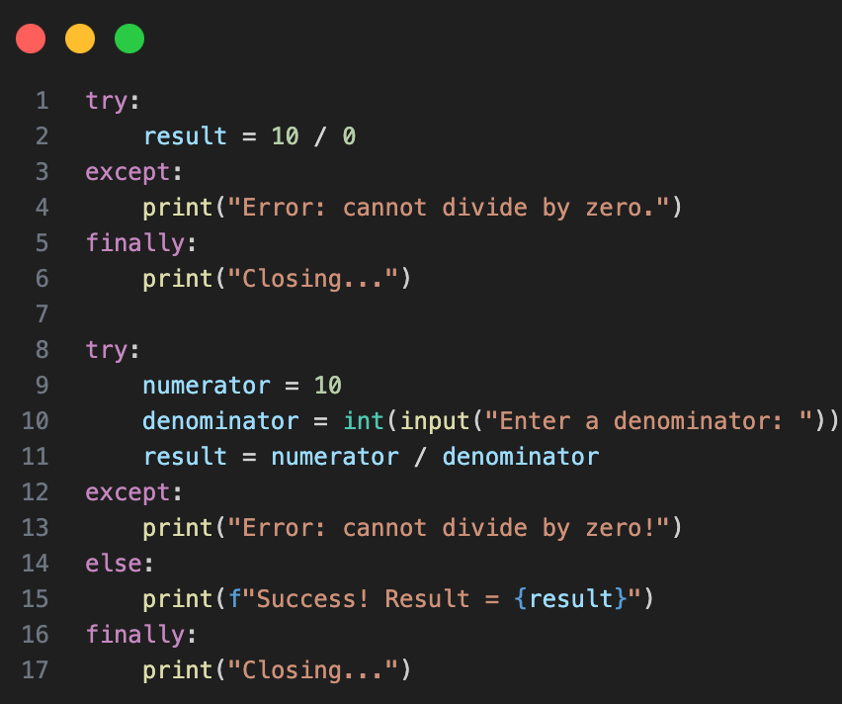
Error Handling
Ref: https://www.w3schools.com/python/python_try_except.asp
Notes:
# ============================================================
# PART 3: ERROR HANDLING
# try/except lets your program handle errors gracefully
# instead of crashing.
# ============================================================
# ------------------------------------------------------------
# 7. TRY / EXCEPT / FINALLY
# try -- code that might cause an error
# except -- what to do IF an error happens
# finally -- ALWAYS runs, error or not (e.g. cleanup)
# ------------------------------------------------------------
# ------------------------------------------------------------
# 8. TRY / EXCEPT / ELSE / FINALLY
# else -- runs ONLY when NO error occurred
# ------------------------------------------------------------
# Flow summary:
# No error -> try -> else -> finally
# Error -> try -> except -> finally

Slide 23
Exercise: To do List
Create an interactive task manager that can:
Display the current to-do list (with numbered items)
Add new tasks
Mark tasks as completed
Move completed tasks to a “Done” list
Display both pending and completed task.
Show the number of pending and completed tasks
Provide a menu for users to choose actions
Include an option to exit the program
Notes:
# ------------------------------------------------------------
# STEP 1 HINTS — show_tasks()
# ------------------------------------------------------------
# Check if pending list is empty:
# if not pending:
# Use enumerate() to print numbers starting from 1:
# for index, task in enumerate(pending, 1):
# Do the same for the done list.
# Print section titles:
# "Pending Tasks:"
# "Done Tasks:"
# Print "No tasks yet." if a list is empty.
# ------------------------------------------------------------
# STEP 2 HINTS — add_task()
# ------------------------------------------------------------
# Ask user for input:
# task = input("Enter a new task: ")
# Add to pending list:
# pending.append(task)
# Print confirmation message.
# ------------------------------------------------------------
# STEP 3 HINTS — complete_task()
# ------------------------------------------------------------
# Ask user for a number:
# number = input("Enter the number of the task you finished: ")
# Convert to int:
# index = int(number) - 1
# Check if index is valid:
# if index >= 0 and index < len(pending):
# Move task:
# done.append(pending[index])
# Remove from pending:
# pending.remove(pending[index])
# OR use: pending.pop(index)
# Handle invalid numbers:
# else:
# print("Invalid task number.")
# (Optional) Use try/except to handle non-number input.
# ------------------------------------------------------------
# STEP 4 HINTS — show_summary()
# ------------------------------------------------------------
# Use len() to count tasks:
# len(pending)
# len(done)
# Print formatted summary:
# --- Summary ---
# Pending : X tasks
# Done : Y tasks

Slide 24
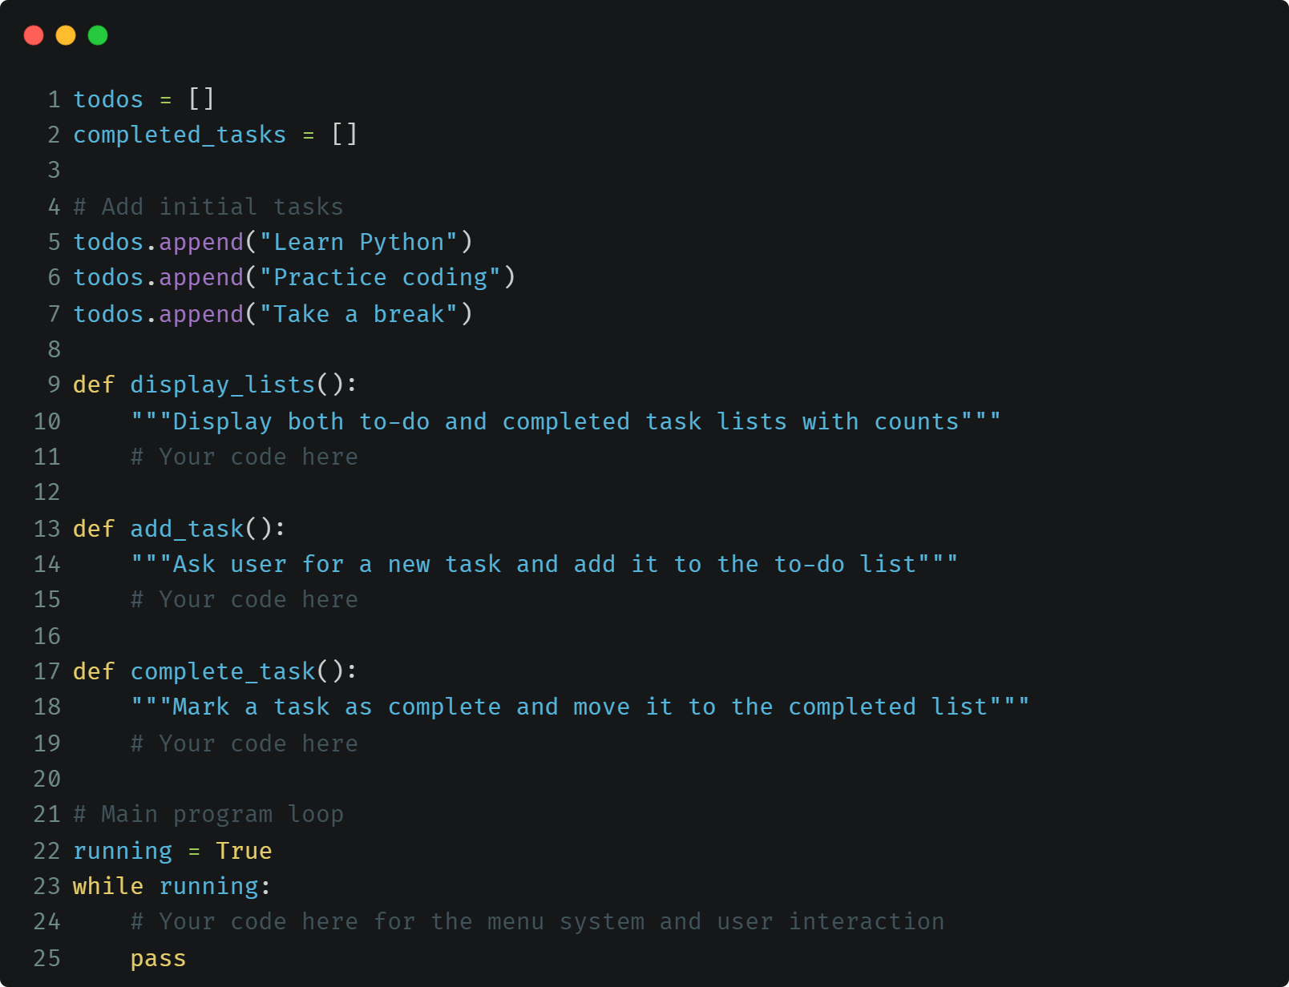
Exercise: Snippet

Slide 25
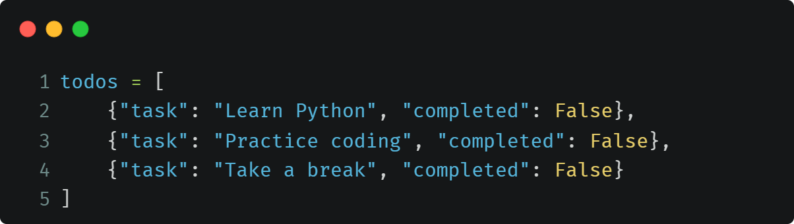
Exercise: To do List (Dictionary)
Rewrite the to do list above in dictionary format.

